Slide 1
Scheme Intro
Leeds Code Dojo

Slide 2
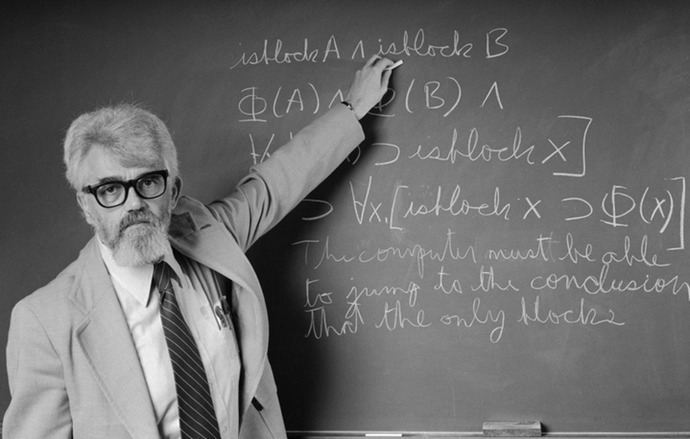
A Brief History of Scheme
1958: John McCarthy invents Lisp at MIT as a way of (manually) studying computing
It’s all about the math

Slide 3
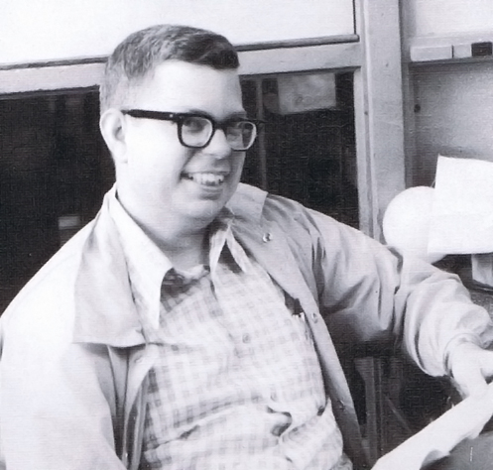
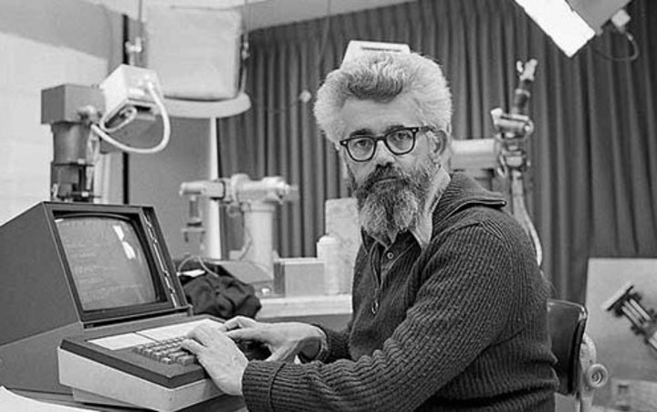
A Brief History of Scheme
1958: Steve Russel implements eval function in machine code, resulting in a Lisp interpreter
Lose the chalk, bro! I made Lisp on your MacBook.
Sweet

Slide 4
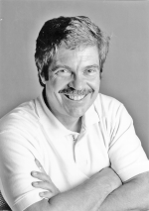
Random Quote #1
"the greatest single programming language ever designed" - Alan Kay, on Lisp

Slide 5
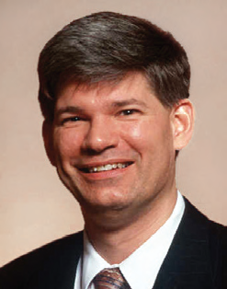
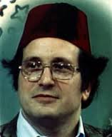
A Brief History of Scheme
1975: Guy Steel & Gerald Sussman create Lisp-based language Schemer to study the newly-proposed actor model
Schemer turns out to be a pretty good language – unfortunately the PDP-10 filesystem only allowed 6 characters, so Scheme is born!
Scheme.r

Slide 6
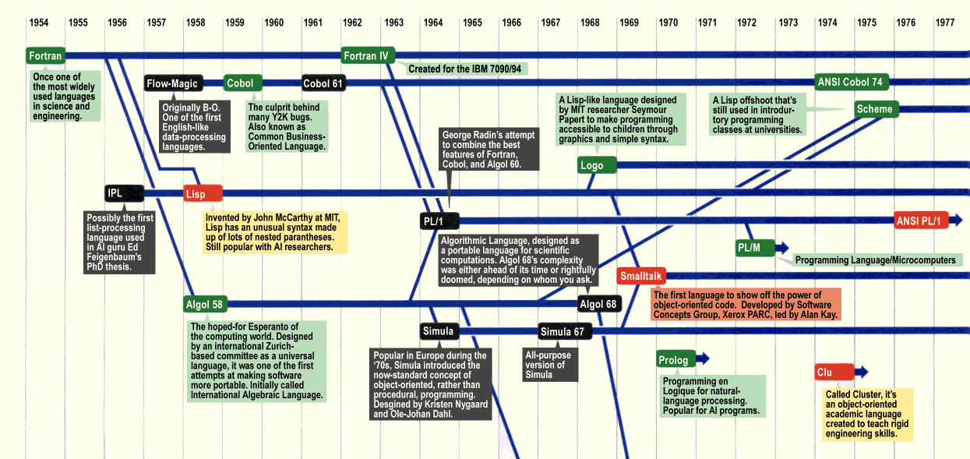
Family Tree

Slide 7
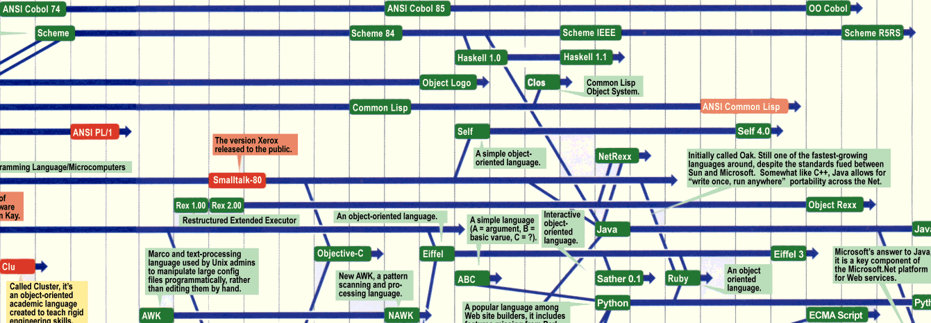
Family Tree
Clojure
Racket

Slide 8
Sample
(define (fizz number)
(define (divisible-by? dividend)
(eq? (modulo number dividend) 0))
(cond
((divisible-by? 15) "FizzBuzz")
((divisible-by? 5) "Buzz")
((divisible-by? 3) "Fizz")
(else (number->string number))))
> (fizz 15)
“FizzBuzz”

Slide 9
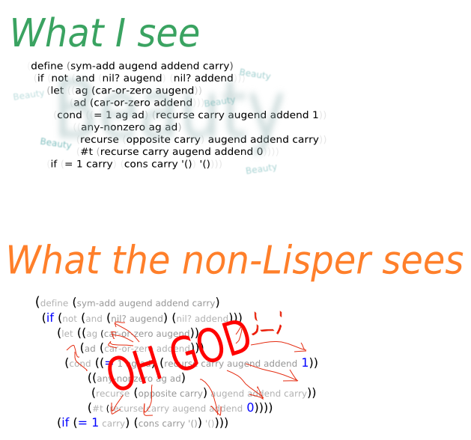
Parentheses

Slide 10
Language Basics
Functional
First-class functions
Expression based
Not immutable
Dynamically typed
Large type system (especially numbers)
Enforced at run time
Homoiconic
Heavy use of recursion & continuations
Tail call optimisation guaranteed

Slide 11
Atoms, Lists & Homoiconicity
Atoms
1
“Hello”
Lists
(1 “Hello” #t)
(“hi” (1 2 3) mum 0.5))
Scheme Programs
(+ 1 2)
(if (eq? 1 2) “hello” 1)

Slide 12
Recursion
(define (contains? list item)
(cond
((null? list) #f)
((eqv? item (car list)) #t)
(else (contains? (cdr list) item))))
Learn to love it..

Slide 13
Why?
Still popular – Clojure, Racket, etc.
Good learning/teaching lang
It’s awesome

Slide 14
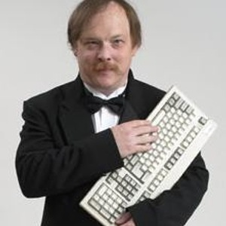
Random Quote #2
"Lisp is worth learning for the profound enlightenment experience you will have when you finally get it; that experience will make you a better programmer for the rest of your days, even if you never actually use Lisp" - Eric Raymond, "How to Become a Hacker"

